Slide 1
Prime Numbers
A prime number is a whole number greater than 1, which is only divisible by 1 and itself.
First few prime numbers are : 2, 3, 5, 7, 11, 13, 17, 19, 23 …..
Primality Test
Algorithm for determining whether an input number is prime

Slide 2
Some interesting fact about Prime numbers
2 is the only even Prime number.
Every prime number can represented in form of 6n+1 or 6n-1, where n is natural number.
2, 3 are only two consecutive natural numbers which are prime too.
Every even integer greater than 2 can be expressed as the sum of two primes (Goldbach Conjecture)

Slide 3
Some interesting fact about Prime numbers
If n is a prime number, then for every a, 1 <= a < n,
a^{n-1} ≡ 1 (mod n)
OR
a^{n-1} % n = 1 (Fermat’s Little Theorem)

Slide 4
How do we check whether a number is Prime or not?
Naive solution
Iterate through all numbers from 2 to n-1 and for every number check if it divides n
static boolean isPrime(int n)
{
// Corner case
if (n <= 1)
return false;
// Check from 2 to n-1
for (int i = 2; i < n; i++)
if (n % i == 0)
return false;
return true;
} Time complexity :O(n)

Slide 5
How do we check whether a number is Prime or not?
2. Efficient solutions
(1) O(sqrt(n)) method: Instead of checking till n, we can check till √n because a larger factor of n must be a multiple of smaller factor that has been already checked
A trial division to test the primality of 100
Divisors of 100: 2, 4, 5, 10, 20, 25, 50
Largest factor is 100/2 = 50
All divisors of n are less than or equal to n/2
Some of divisors are redundant
Once we reach 10, which is √100, the divisors just flip around and repeat

Slide 6
How do we check whether a number is Prime or not?
More optimized solution
Every natural number can be represented as 6k + i for i= 0,1,2,3,4,5
All primes are of the form 6k ± 1, with the exception of 2 and 3. So, check through all the numbers of form 6k ± 1 only.

Slide 7
How do we check whether a number is Prime or not?
static boolean isPrime(int n)
{
// Corner cases
if (n <= 1) return false;
if (n <= 3) return true;
// This is checked so that we can skip
// middle five numbers in below loop
if (n % 2 == 0 || n % 3 == 0) return false;
for (int i = 5; i * i <= n; i = i + 6)
if (n % i == 0 || n % (i + 2) == 0)
return false;
return true;
}
Time complexity :O(√n)

Slide 8
Full Prime Number
class Prime{
// function to check digits
public static boolean checkDigits(int n)
{
// check all digits are prime or not
while (n > 0) {
int dig = n % 10;
// check if digits are prime or not
if (dig != 2 && dig != 3 &&
dig != 5 && dig != 7)
return false;
n /= 10;
}

Slide 9
return true;
}
// To check if n is prime or not
public static boolean prime(int n)
{
if (n == 1)
return false;
// check for all factors
for (int i = 2; i * i <= n; i++) {
if (n % i == 0)
return false;
}
return true;
}

Slide 10
// To check if n is Full Prime
public static boolean isFullPrime(int n)
{
// The order is important here for
// efficiency
return (checkDigits(n) && prime(n));
}
// driver code
public static void main(String[] args)
{
int n = 53;
if (isFullPrime(n))
System.out.print( "Yes" );
else
System.out.print( "No");
}
}

Slide 11
How do we check whether a number is Prime or not?
(2) Fermat’s Little Theorem:
If n is a prime number, then for every a, 1 <= a < n,
a^{n-1} ≡ 1 (mod n)
OR
a^{n-1} % n = 1
e.g. Since 7 is prime,
2⁶ ≡ 1 (mod 7),
3⁶ ≡ 1 (mod 7),
4⁶ ≡ 1 (mod 7)
5⁶ ≡ 1 (mod 7) and
6⁶ ≡ 1 (mod 7)

Slide 12
How do we check whether a number is Prime or not?
(2) Fermat’s Little Theorem:
If n is a prime number, then for every a, 1 <= a < n,
a^{n-1} ≡ 1 (mod n)
OR
a^{n-1} % n = 1
If a given number is prime, then this method always returns true
If given number is composite (or non-prime), then it may return true or false (but the probability of producing incorrect result for composite is low and can be reduced by doing more iterations)

Slide 13
How do we check whether a number is Prime or not?
(2) Fermat’s Little Theorem:
// Higher value of k indicates probability of correct results for composite inputs become higher. For prime inputs, result is always correct
Step 1 Repeat following k times:
a) Pick a randomly in the range [2, n - 2]
b) If a^{n-1} ≢ 1 (mod n), then return false
Step 2 Return true [probably prime].

Slide 14
How do we check whether a number is Prime or not?
(3) Sieve of Eratosthenes:
The sieve of Eratosthenes is one of the most efficient ways to find all primes smaller than n when n is smaller than 10 million or so
Time complexity : O(nloglogn)

Slide 15
How do we check whether a number is Prime or not?
(3) Sieve of Eratosthenes:
Create a list of consecutive integers from 2 to n: (2, 3, 4, …, n)
Initially, let p equal 2, the first prime number.
Starting from p, count up in increments of p and mark each of these numbers greater than p itself in the list. (some of them may have already been marked)
Find the first number greater than p in the list that is not marked. If there was no such number, stop. Otherwise, let p now equal this number (which is the next prime), and repeat from step 3.

Slide 16
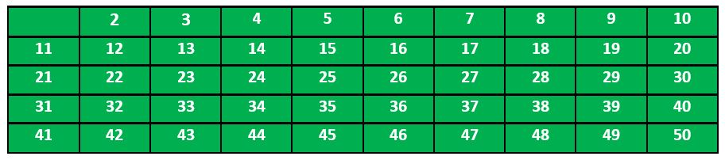
e.g. when n = 50,
Step 1: print all print numbers smaller than or equal to 50.
Step 2: Initialize p = 2
Step 3: Mark all the numbers which are divisible by p

Slide 17
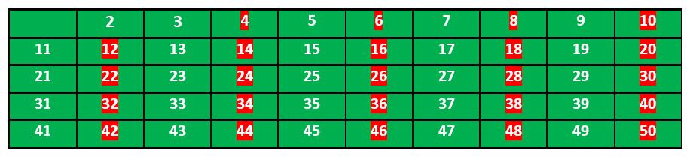
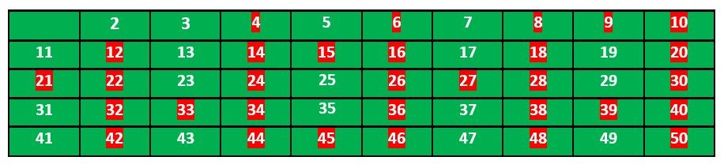
Step 4: Find the first number greater than p in the list that is not marked.
p=3, repeat Step 3

Slide 18
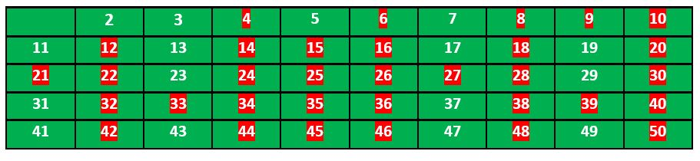
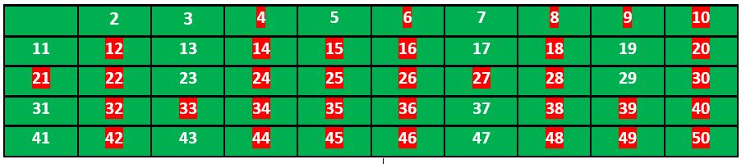
Now, p=5,
Continue this process and our final table will look like as below,

Slide 19
void sieveOfEratosthenes(int n){
boolean prime[] = new boolean[n+1];
for(int i=0;i<n;i++)
prime[i] = true;
for(int p = 2; p*p <=n; p++){
if(prime[p] == true){
for(int i = p*2; i <= n; i += p)
prime[i] = false;
}
}
for(int i = 2; i <= n; i++){
if(prime[i] == true)
System.out.print(i + " ");
}
}

Slide 20
How do we check whether a number is Prime or not?
(3) Sieve of Eratosthenes:
when n is large
An array of size Θ(n) may not fit in memory
The simple Sieve is not cache friendly even for slightly bigger n. The algorithm traverses the array without locality of reference

Slide 21
How do we check whether a number is Prime or not?
(4) Segmented Sieve:
Divide the range [0..n-1] in different segments
Size of each segment is √n
Compute primes in all segments one by one

Slide 22
Segmented Sieve The idea of segmented sieve is to divide the range [0..n-1] in different segments and compute primes in all segments one by one. This algorithm first uses Simple Sieve to find primes smaller than or equal to √(n). Below are steps used in Segmented Sieve.
1. Use Simple Sieve to find all primes upto square root of ‘n’ and store these primes in an array “prime[]”. Store the found primes in an array ‘prime[]’.
2. We need all primes in range [0..n-1]. We divide this range in different segments such that size of every segment is at-most √n
3. Do following for every segment [low..high]
Create an array mark[high-low+1]. Here we need only O(x) space where x is number of elements in given range.
Iterate through all primes found in step 1. For every prime, mark its multiples in given range [low..high].
In Simple Sieve, we needed O(n) space which may not be feasible for large n. Here we need O(√n) space and we process smaller ranges at a time (locality of reference)

Slide 23
Find all prime factors of a given number
Every natural number greater than 1 is either a prime itself or can be factorized as a product of primes that is unique up to their order. E.g. 315, can be written as 3 *3 * 5* 7
Writing a number as a product of prime numbers is called a prime factorization of the number. e.g. 3, 3, 5, 7 are prime factors of 315

Slide 24
Find all prime factors of a given number
1) While n is divisible by 2, print 2 and divide n by 2.
2) After step 1, n must be odd. Now start a loop from i = 3 to square root of n. While i divides n, print i and divide n by i, increment i by 2 and continue.
3) If n is a prime number and is greater than 2, then n will not become 1 by above two steps. So print n if it is greater than 2.

Slide 25
Find all prime factors of a given number
While n is divisible by 2, print 2 and divide n by 2.
while (n%2==0)
{
System.out.print(2 + " ");
n /= 2;
}

Slide 26
Find all prime factors of a given number
2) After step 1, n must be odd. Now start a loop from i = 3 to square root of n. While i divides n, print i and divide n by i, increment i by 2 and continue.
for (int i = 3; i <= Math.sqrt(n); i+= 2)
{
while (n%i == 0)
{
System.out.print(i + " ");
n /= i;
}
}

Slide 27
Find all prime factors of a given number
3) If n is a prime number and is greater than 2, then n will not become 1 by above two steps. So print n if it is greater than 2.
if (n > 2)
System.out.print(n);

Slide 28
Find all prime factors of a given number
1) While n is divisible by 2, print 2 and divide n by 2.
2) After step 1, n must be odd. Now start a loop from i = 3 to square root of n. While i divides n, print i and divide n by i, increment i by 2 and continue.
3) If n is a prime number and is greater than 2, then n will not become 1 by above two steps. So print n if it is greater than 2.

Slide 29
Least prime factor of numbers till n
The least prime factor of an integer n is the smallest prime number that divides the number
A prime number is its own least prime factor (as well as its own greatest prime factor)
The least prime factor of all even numbers is 2
Input : 6
Output : Least Prime factor of 1: 1
Least Prime factor of 2: 2
Least Prime factor of 3: 3
Least Prime factor of 4: 2
Least Prime factor of 5: 5
Least Prime factor of 6: 2

Slide 30
Least prime factor of numbers till n
1. Create a list of consecutive integers from 2 through n: (2, 3, 4, …, n).
2. Initially, let i equal 2, the smallest prime number.
3. Generate the multiples of i by counting from 2*i to n, and mark them as having least prime factor as i (if not already marked). Also mark i as least prime factor of i (i itself is a prime number).
4. Find the first number greater than i in the list that is not marked. If there was no such number, stop. Otherwise, let i now equal this new number (which is the next prime), and repeat from step 3

Slide 31
Least prime factor of numbers till n
int[] least_prime = new int[n+1];
//least_prime[1] = 1;
for (int i = 2; i <= n; i++){
if (least_prime[i] == 0){
least_prime[i] = i;
for (int j = 2*i; j <= n; j += i)
if (least_prime[j] == 0)
least_prime[j] = i;
}
} Time Complexity: O(nlog(n))
Auxiliary Space: O(n)

Slide 32
Prime Factorization using Sieve O(log n)
1. Use PrimeFactors[] to store result
2. i = 0
3. while n != 1 :
PrimeFactors[i] = LPF[n] (LPF is Least Prime Factor)
i++
n = n / LPF[n]

Slide 33
Prime Factorization using Sieve O(log n) for multiple queries
1. Use PrimeFactors[] to store result
2. i = 0
3. while n != 1 :
PrimeFactors[i] = LPF[n] (LPF is Least Prime Factor)
i++
n = n / LPF[n]

Slide 34
Twin Prime
using namespace std;
void printTwinPrime(int n)
{
bool prime[n + 1];
memset(prime, true, sizeof(prime));
for (int p = 2; p * p <= n; p++) {
if (prime[p] == true) {
for (int i = p * 2; i <= n; i += p)
prime[i] = false;
}
}
for (int p = 2; p <= n - 2; p++)
if (prime[p] && prime[p + 2])
cout << "(" << p << ", " << p + 2 << ")" ;
}

Slide 35
Twisted Prime
#include <bits/stdc++.h>
using namespace std;
int reverse(int n)
{
int rev = 0, r;
while (n > 0) {
r = n % 10;
rev = rev * 10 + r;
n /= 10;
}
return rev;
}

Slide 36
bool isPrime(int n)
{
if (n <= 1)
return false;
if (n <= 3)
return true;
if (n % 2 == 0 || n % 3 == 0)
return false;
for (int i = 5; i * i <= n; i = i + 6)
if (n % i == 0 || n % (i + 2) == 0)
return false;
return true;
}

Slide 37
bool checkTwistedPrime(int n)
{
if (isPrime(n) == false)
return false;
return isPrime(reverse(n));
}

Slide 38
Sieve Of Atkin
The sieve of Atkin is a modern algorithm for finding all prime numbers up to a specified integer. Compared with the ancient Sieve of Eratosthenes , which marks off multiples of primes, it does some preliminary work and then marks off multiples of squares of primes, that’s why it has a better theoretical asymptotic complexity with Complexity of (N / (log log N))

Slide 39
Create a results list, filled with 2, 3, and 5.
Create a sieve list with an entry for each positive integer; all entries of this list should initially be marked non prime.
For each entry number n in the sieve list, with modulo-sixty remainder r:
If r is 1, 13, 17, 29, 37, 41, 49, or 53, flip the entry for each possible solution to 4x² + y² = n.
If r is 7, 19, 31, or 43, flip the entry for each possible solution to 3x² + y² = n.
If r is 11, 23, 47, or 59, flip the entry for each possible solution to 3x² – y² = n when x > y.
If r is something else, ignore it completely..
Start with the lowest number in the sieve list.
Take the next number in the sieve list still marked prime.
Include the number in the results list.
Square the number and mark all multiples of that square as non prime. Note that the multiples that can be factored by 2, 3, or 5 need not be marked, as these will be ignored in the final enumeration of primes.
Repeat steps four through seven

Slide 40
// C++ program for implementation of Sieve of Atkin
#include <bits/stdc++.h>
using namespace std;
int SieveOfAtkin(int limit)
{
// 2 and 3 are known to be prime
if (limit > 2)
cout << 2 << " ";
if (limit > 3)
cout << 3 << " ";
// Initialise the sieve array with false values
bool sieve[limit];
for (int i = 0; i < limit; i++)
sieve[i] = false;
/* Mark siev[n] is true if one
of the following is true:
a) n = (4*x*x)+(y*y) has odd number of
solutions, i.e., there exist
odd number of distinct pairs (x, y)
that satisfy the equation and
n % 12 = 1 or n % 12 = 5.
b) n = (3*x*x)+(y*y) has odd number of
solutions and n % 12 = 7
c) n = (3*x*x)-(y*y) has odd number of
solutions, x > y and n % 12 = 11 */
for (int x = 1; x * x < limit; x++) {
for (int y = 1; y * y < limit; y++) {
// Main part of Sieve of Atkin
int n = (4 * x * x) + (y * y);
if (n <= limit && (n % 12 == 1 || n % 12 == 5))
sieve[n] ^= true;
n = (3 * x * x) + (y * y);
if (n <= limit && n % 12 == 7)
sieve[n] ^= true;
n = (3 * x * x) - (y * y);
if (x > y && n <= limit && n % 12 == 11)
sieve[n] ^= true;
}
}
// Mark all multiples of squares as non-prime
for (int r = 5; r * r < limit; r++) {
if (sieve[r]) {
for (int i = r * r; i < limit; i += r * r)
sieve[i] = false;
}
}
// Print primes using sieve[]
for (int a = 5; a < limit; a++)
if (sieve[a])
cout << a << " ";
}
// Driver program
int main(void)
{
int limit = 20;
SieveOfAtkin(limit);
return 0;
}

Slide 41
How it Works:
1. The algorithm treats 2, 3 and 5 as special cases and just adds them to the set of primes to start with.
2. Like Sieve of Eratosthenes, we start with a list of numbers we want to investigate. Suppose we want to find primes <=100, then we make a list for [5, 100]. As explained in (1), 2, 3 and 5 are special cases and 4 is not a prime.
3. The algorithm talks in terms of modulo-60 remainders. .
4. All numbers with modulo-sixty remainder 1, 13, 17, 29, 37, 41, 49, or 53 have a modulo-twelve remainder of 1 or 5. These numbers are prime if and only if the number of solutions to 4×2+y2=n is odd and the number is squarefree. A square free integer is one which is not divisible by any perfect square other than 1.
5. All numbers with modulo-sixty remainder 7, 19, 31, or 43 have a modulo-six remainder of 1. These numbers are prime if and only if the number of solutions to 3x² + y² = n is odd and the number is squarefree.
6. All numbers with modulo-sixty remainder 11, 23, 47, or 59 have a modulo-twelve remainder of 11. These numbers are prime if and only if the number of solutions to 3x² – y² = n is odd and the number is squarefree.

Slide 42
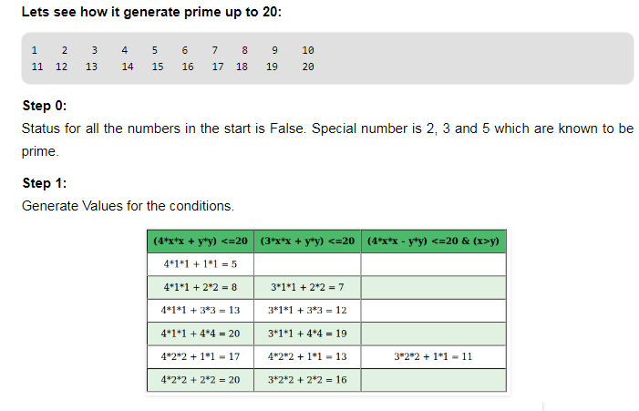

Slide 43
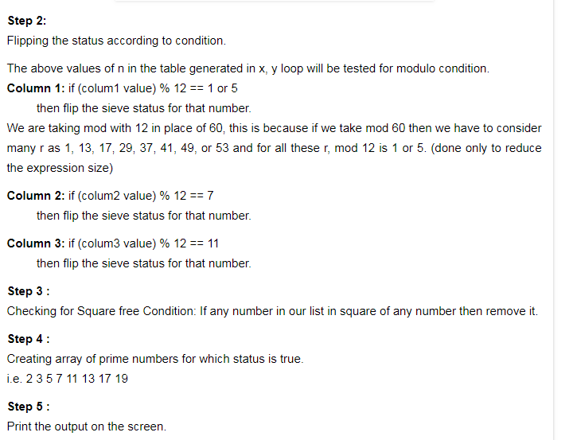

Slide 44
Problems to solve
6. Check if a number is Full Prime
7. Insert minimum number in array so that sum of array becomes prime
8. Find the prime numbers which can written as sum of most consecutive primes
9. Find two prime numbers with given sum
10. Twisted Prime Number
11. Almost Prime Numbers

Slide 45
Problems to solve
12. Check if a number can be written as a sum of ‘k’ prime numbers
13. Special prime numbers
14. Twin Prime Numbers between 1 and n
15. K-Primes (Numbers with k prime factors) in a range

